Slide 1




PROJECT RECYCLE
AN ANALYSIS OF SOLID WASTE MANAGEMENT SYSTEM IN THIRUVANANTHAPURAM MUNICIPAL CORPORATION
A Project by
Team BitPlease
Tech Department of Sahridaya

Slide 2
OUR MOTIVE
To do an analysis of existing inflow and outflow of solid waste, and to identify gaps in the existing system.
Generating a mathematical model of a good waste management system.
Use the model for easy implementation in other districts by simple input of basic parameters.

Slide 3
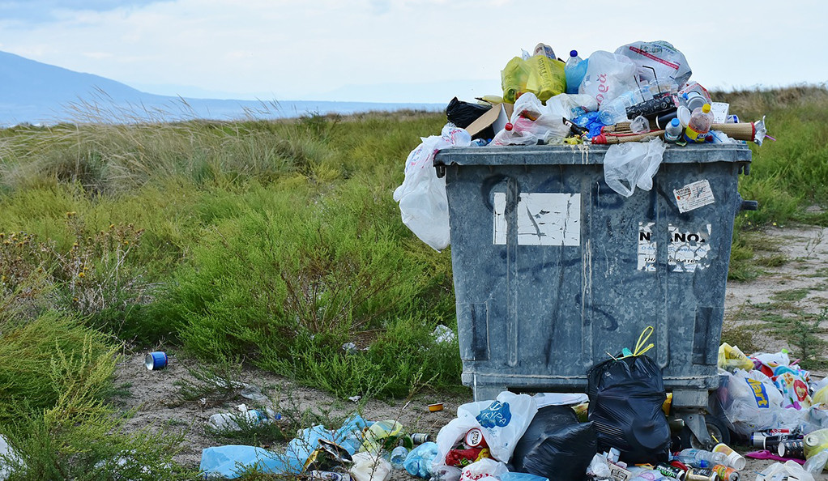
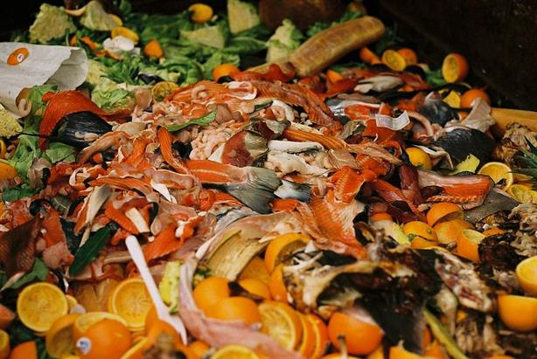
SOLID WASTE
Solid waste is the unwanted or useless solid materials generated from human activities in residential, industrial or commercial areas.
1
2
Non-biodegradable
Biodegradable (our focus)

Slide 4
Solid Waste Management in India
Waste management rules in India are based on the principles of "sustainable development", "precaution" and "polluter pays".
With rapid urbanisation, the country is facing massive waste management challenge.
Urban population - 377 million in 7,935 towns
Generated Municipal Waste - 62 million tonnes (MT)
Waste collected - 43 million tonnes
Waste treated - 11.9 MT
Waste dumped in landfill sites - 31 MT

Slide 5
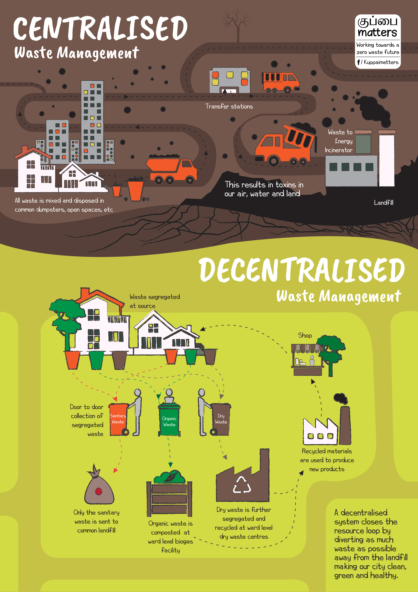
WASTE MANAGEMENT SYSTEMS
CENTRALISED - Our garbage is collected and dumped into open landfills that continue to be filled up past their life expectancy and carrying capacity.
DECENTRALISED - A decentralised system follows the ‘Proximity Principle’, meaning waste is treated as close to the place of generation as possible.

Slide 6
Solid Waste Management in Thiruvananthapuram Municipal Corporation
Thiruvananthapuram Municipal Corporation (TMC) has been promoting decentralized solid waste management and encourages on-site management of biodegradable discards since 2013.
Lack of land and increasing population density.
Overflow system

Slide 7
SCOPE OF STUDY
Type of waste – Bio-degradable solid waste
Area under study – Thiruvananthapuram Municipal Corporation (214.86 sq. km, 100 wards)

Slide 8
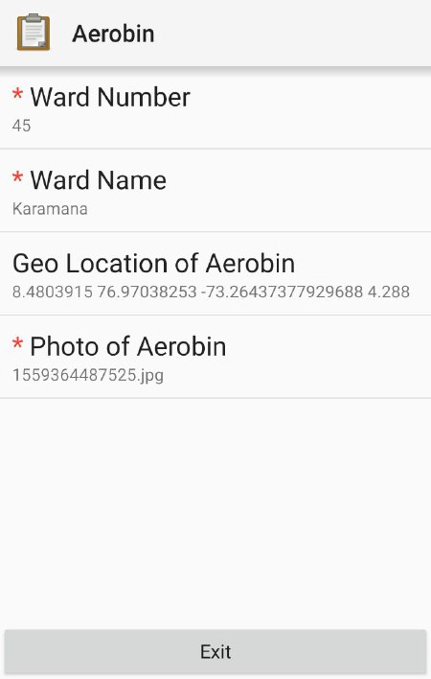
DATA COLLECTION PROCESS
Meeting with Health Inspector (H.I.) of TMC office.
Visiting Office of H.I.s in each ward, collecting data about waste management.
Collecting inflow and outflow of existing Aerobic bins (or Aero bins).
Geotagging and recording the information of each Aero bin location using Open Data Kit (ODK).

Slide 9
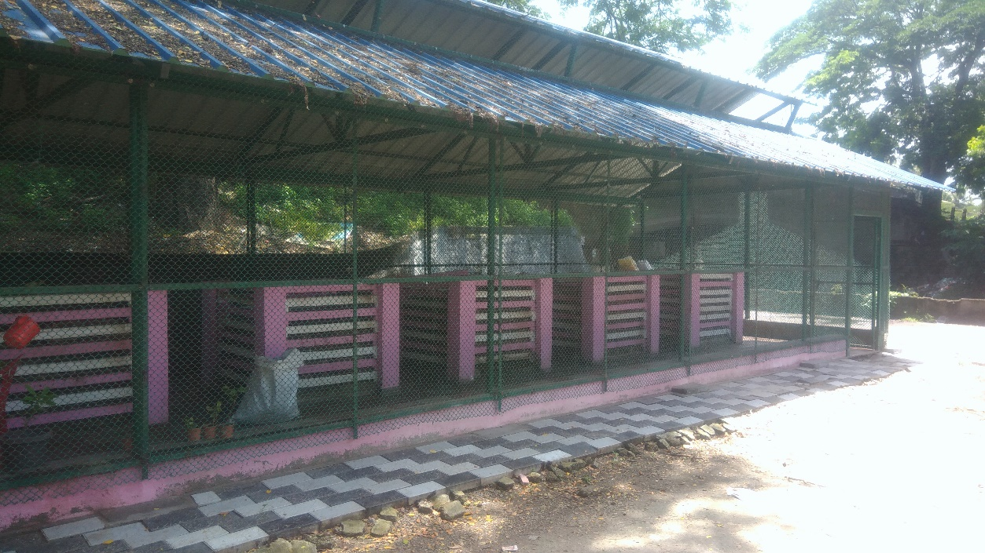
AEROBIC BINS
Aerobic bins can be used to convert biodegradable waste into compost, which can then be used for soil conditioning for farming and gardening.
4ft x 4ft x 4ft Ferro-cement structure

Slide 10
DATA PROCESSING
Digitizing of ledger book data.
Importing the data into R and analysing.
Exporting data collected using ODK into Comma-separated values (csv).
Importing the data to QGIS and processing.
Generating a mathematical model with the help of all the collected data.

Slide 11
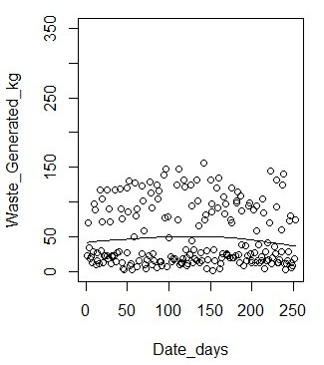
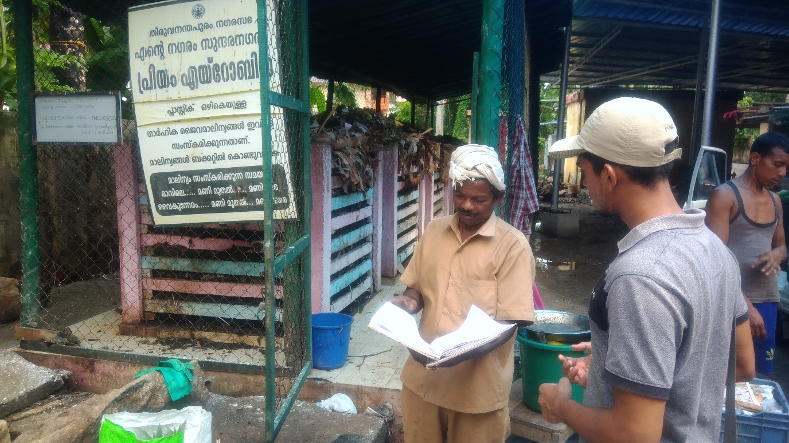
ANALYSIS OF CURRENT WASTE GENERATION
Data collection process
Data Representation

Slide 12
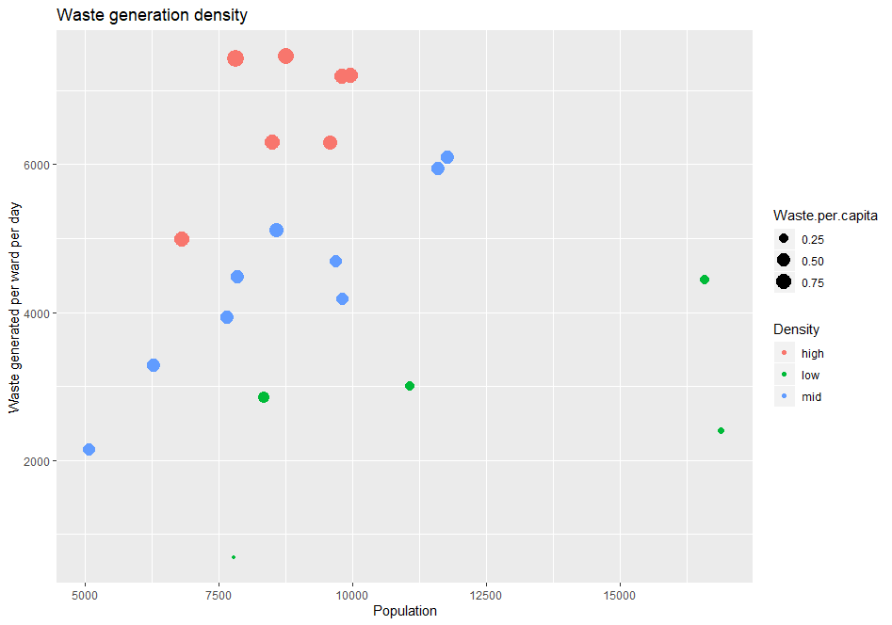
Ward | Population | Waste generated | Waste per capita | Density
Vattiyoorkavu | 9967 | 7200 | 0.722384 | high
Ulloor | 11599 | 5940 | 0.512113 | mid
Palayam | 5069 | 2148 | 0.423752 | mid
Medical College | 6817 | 4986 | 0.731407 | high
Manacaud | 7853 | 4476 | 0.569973 | mid
Jagathy | 8348 | 2850 | 0.341399 | low
Sreekaryam | 11782 | 6096 | 0.517399 | mid
Kazhakkuttam | 16882 | 2400 | 0.142163 | low
Sasthamangalam | 9810 | 7182 | 0.73211 | high
Thirumala | 8750 | 7470 | 0.853714 | high
Thiruvallom | 16580 | 4446 | 0.268154 | low
Vizhinjam | 8498 | 6300 | 0.741351 | high
Karamana | 9810 | 4182 | 0.4263 | mid
Fort | 6296 | 3282 | 0.521283 | mid
Nemom | 8576 | 5112 | 0.596082 | mid
Kudappanakkunnu | 9576 | 6300 | 0.657895 | high
Nanthancode | 9677 | 4692 | 0.484861 | mid
Sreekandeswaram | 7661 | 3936 | 0.513771 | mid
Kadakampally | 11075 | 3006 | 0.271422 | low
Poonthura | 7825 | 7434 | 0.950032 | high
Chalai | 7788 | 684 | 0.087827 | low
WASTE GENERTION DENSITY

Slide 13
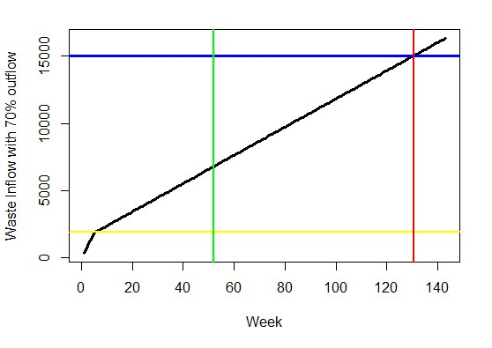
WASTE INFLOW AND OUTFLOW WITH WEEKS
Waste deposited in aerobic bin per ward
Outflow starts
End of existing data
Overflow limit
Week at overflow
Average No of bins in one MRF= 10 Average Capacity of 1 bin= 1.5 T

Slide 14
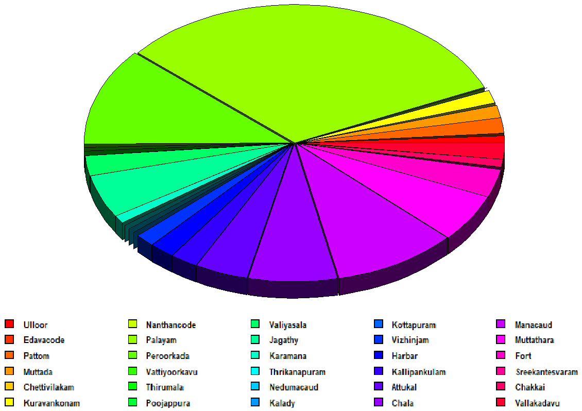
WASTE PROCESSING CAPABILITY
Ratio of amount of waste processed to the total amount of input waste.
Each section in the chart represents a wards with similar ratio.

Slide 15
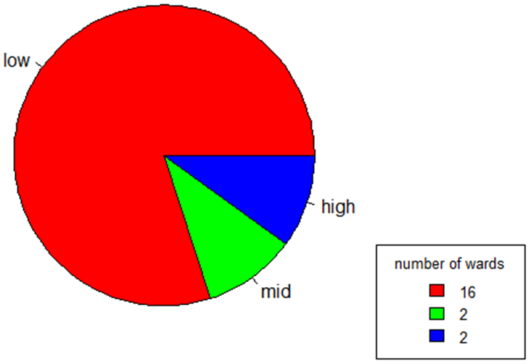
WASTE INFLOW FROM COLLECTED DATA
Average waste inflow rate per day
Low – 0 to 50 kg
Mid – 50 to 150 kg
High – more than 150 kg

Slide 16
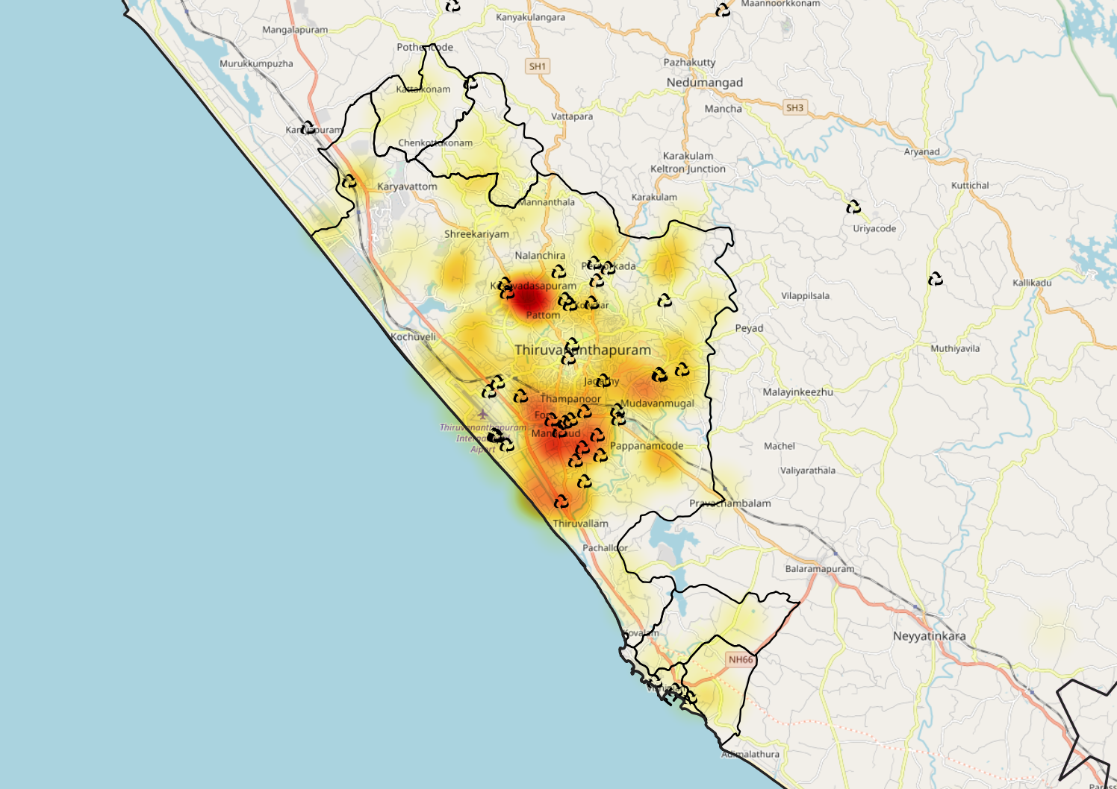
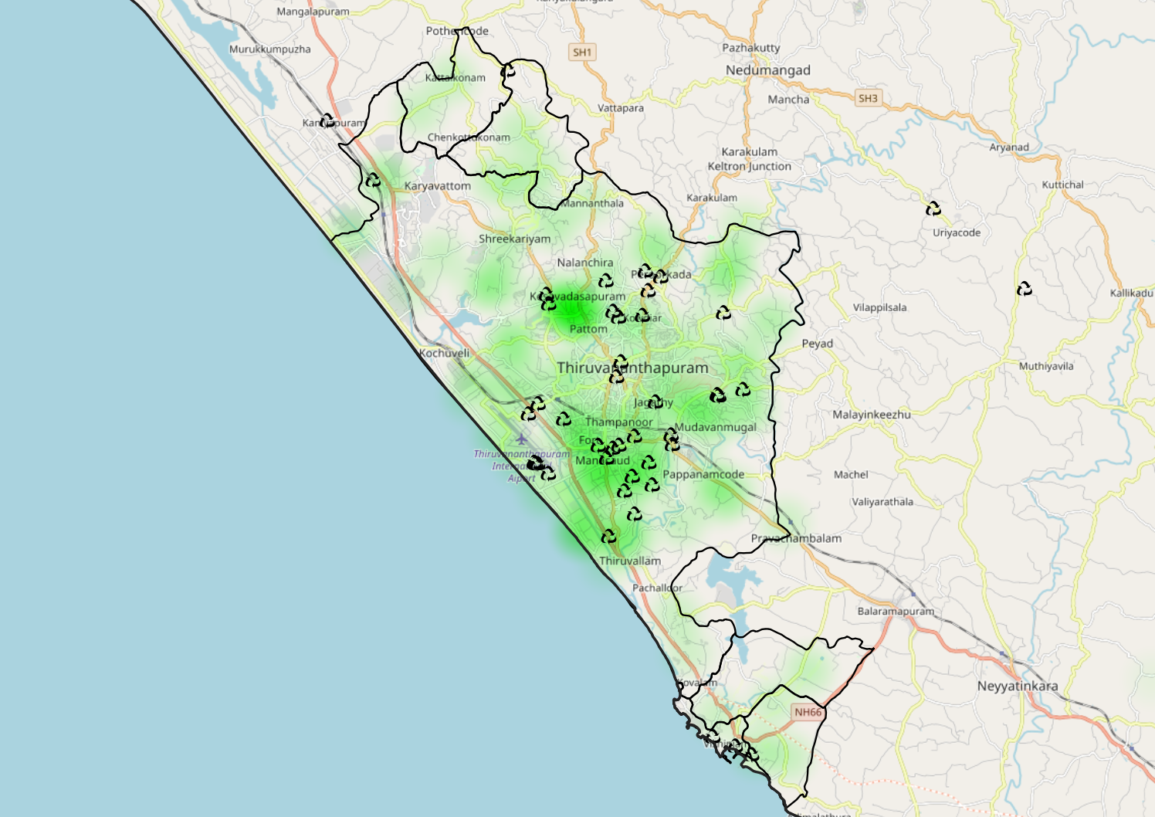
HEAT MAPS OF TMC
Population Density Map
Waste Generation Density

Slide 17
MATHEMATICAL MODEL
Number of Aero bin units in each ward:-
Waste generated per capita per day
Population
Waste generated in the ward per day
Ward population
Number of Aero bins required
Maximum Aero bin capacity
Waste generated by TMC per day
Reducing the effect of source level elimination

Slide 18
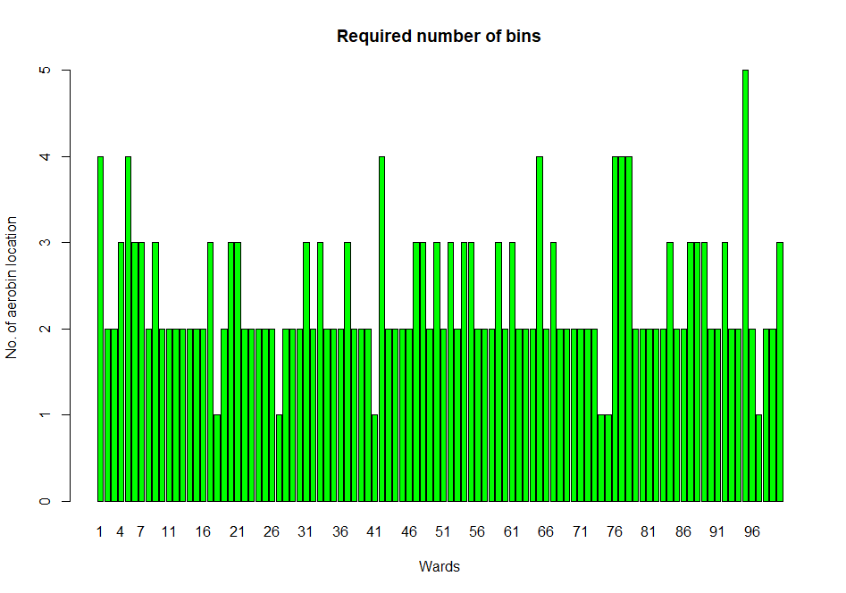
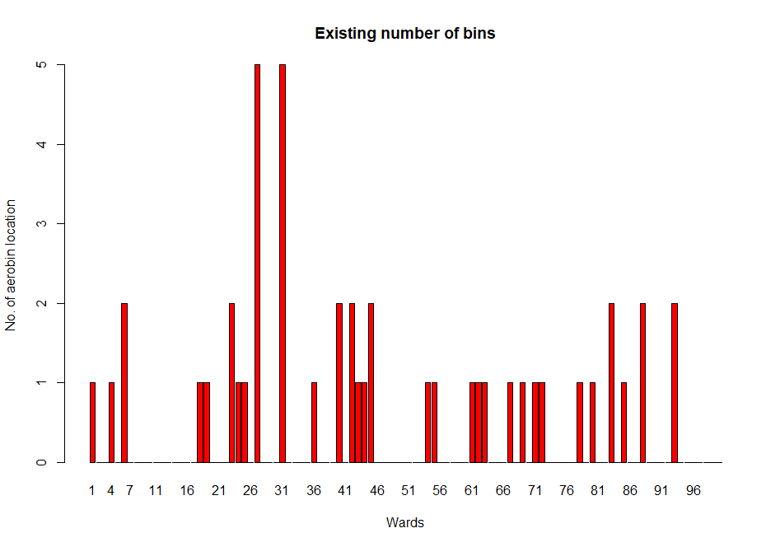
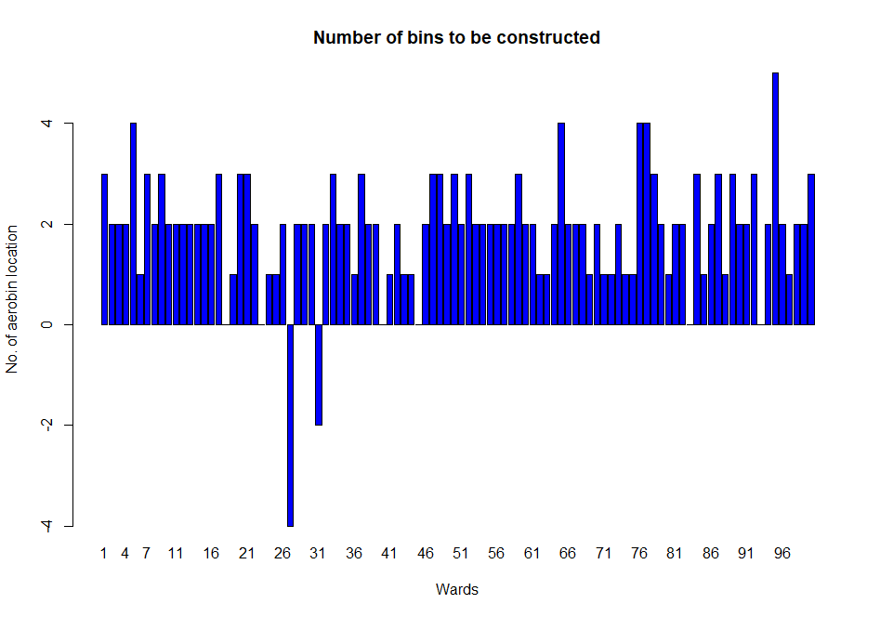

Slide 19
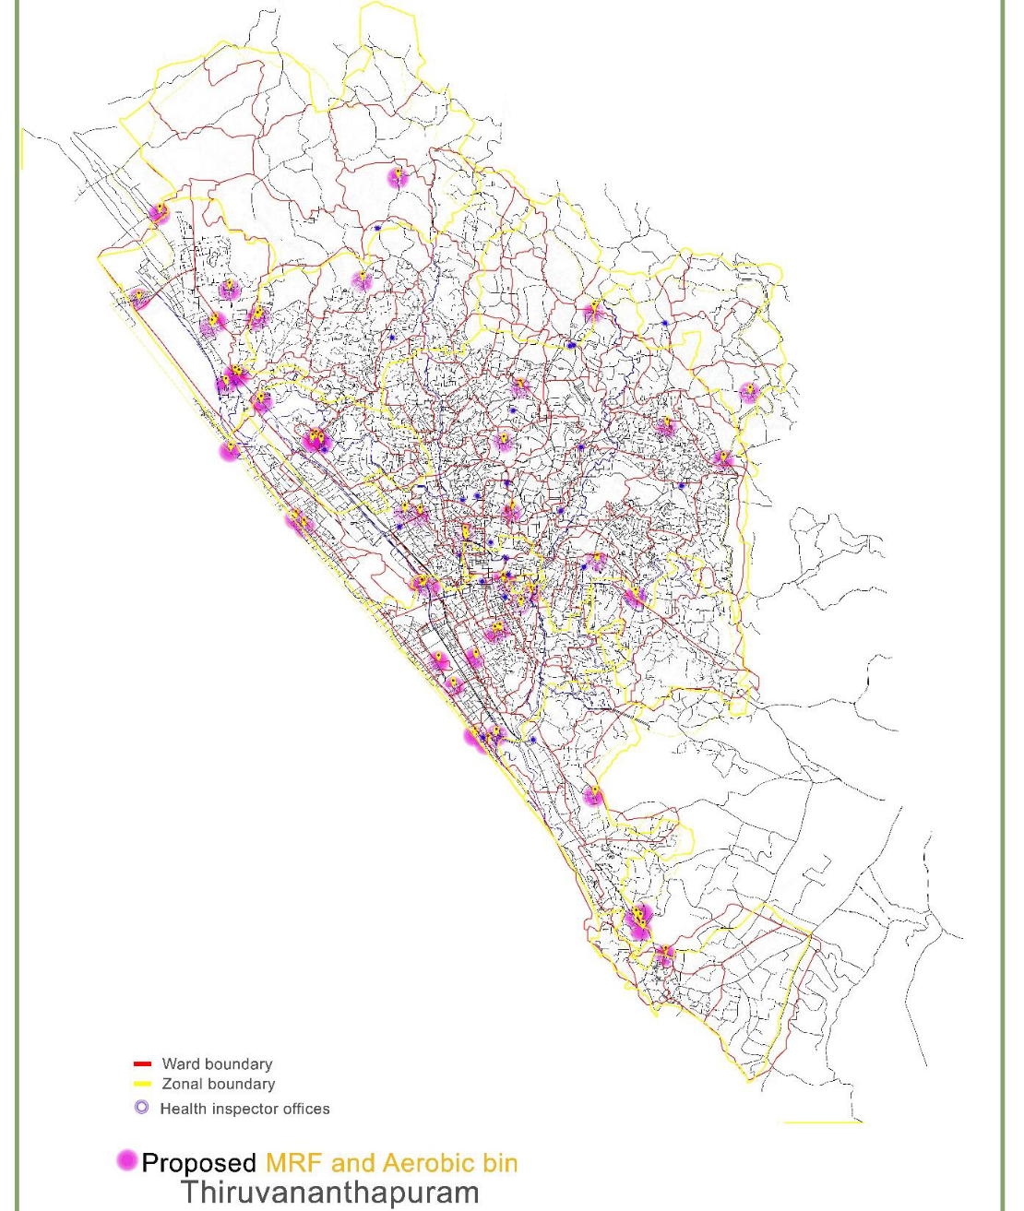
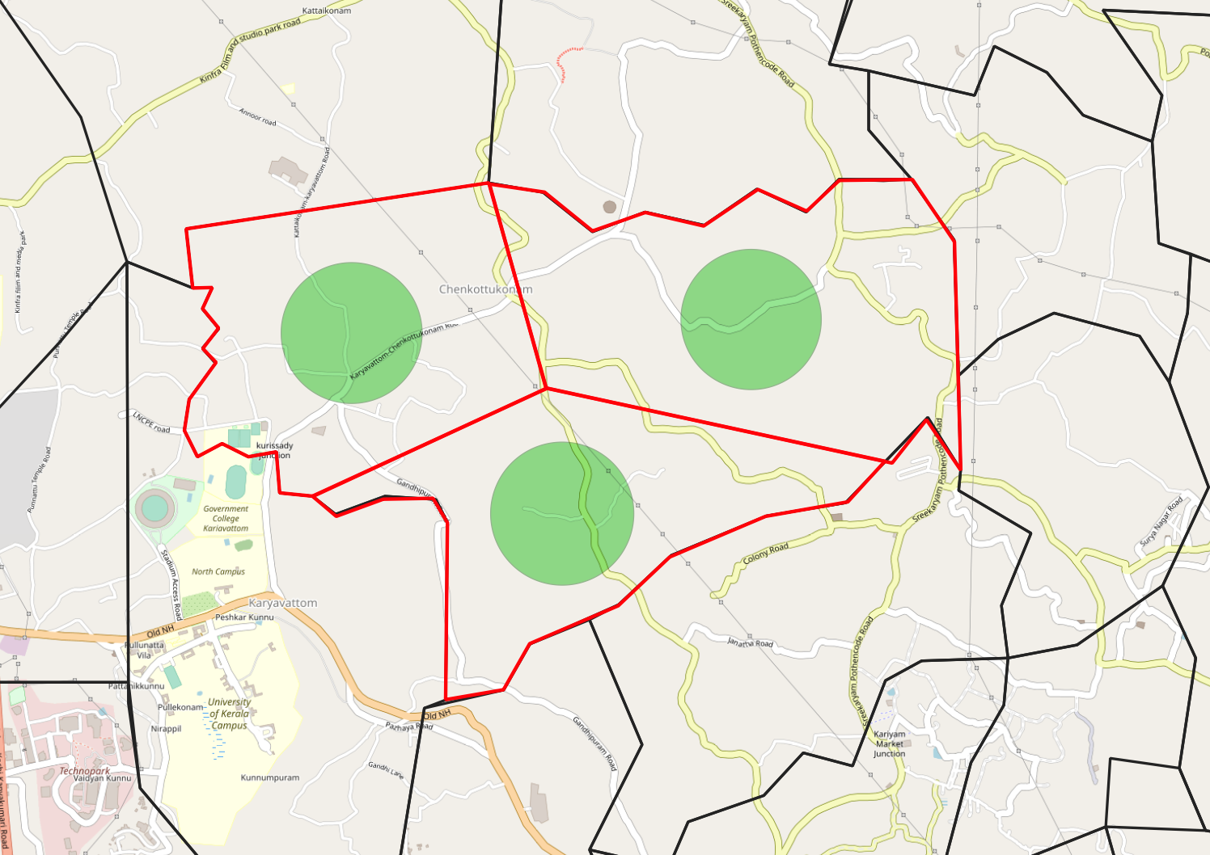
B. Proposed location of Aero bin units in each ward:-
Represents the range within which the aerobin should be placed.
Represents division of ward area.

Slide 20
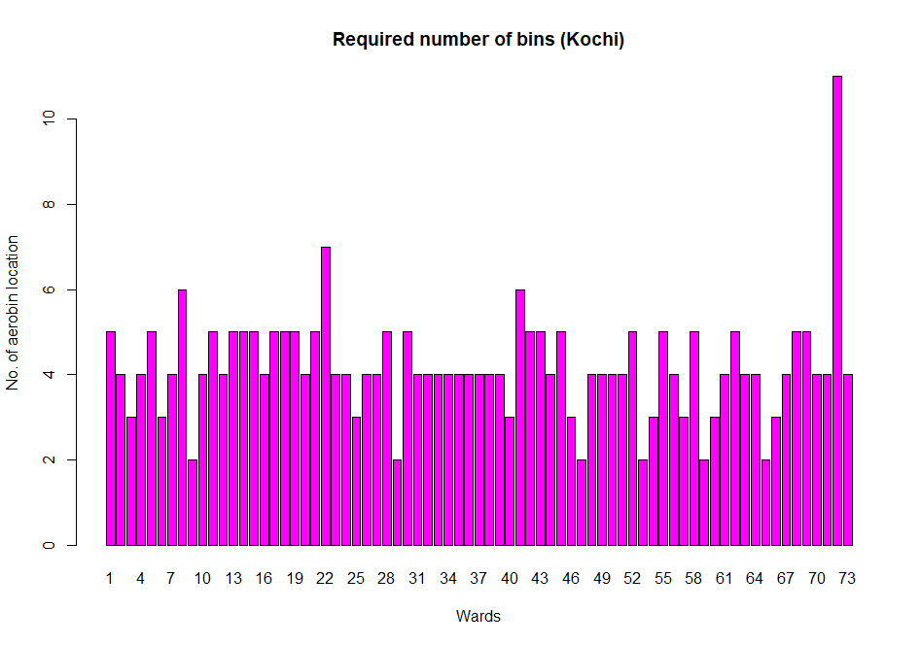
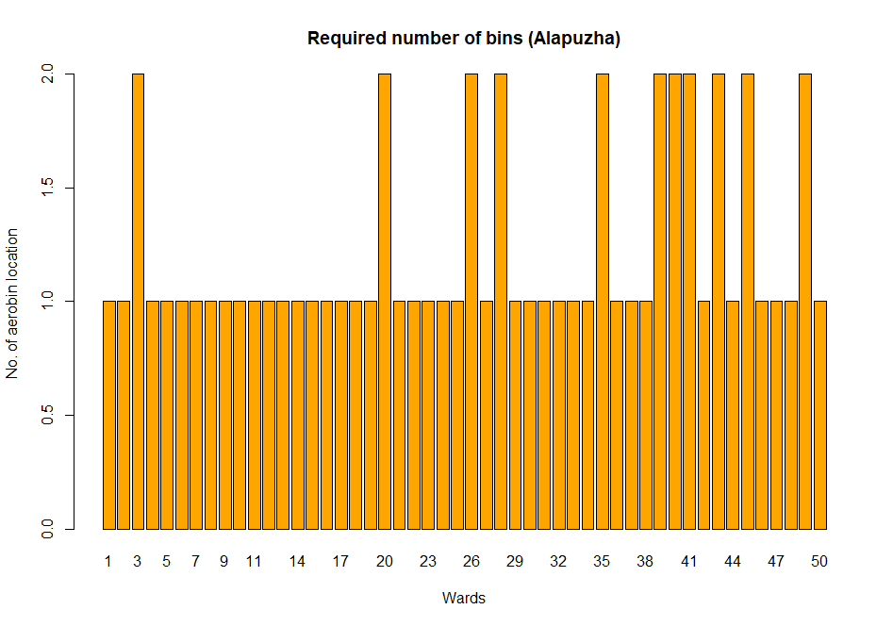
MATHEMATICAL MODEL APPLIED ON OTHER DISTRICTS

Slide 21
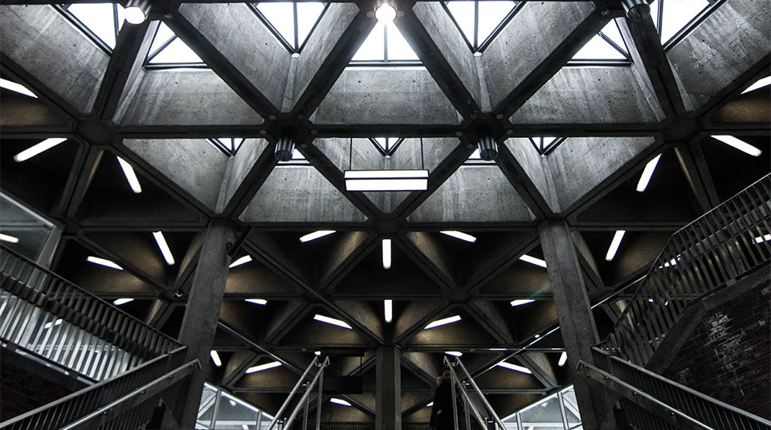
THANK YOU
2
+
2
+

